Slide 1
A core Course on Modeling
Introduction to Modeling
0LAB0 0LBB0 0LCB0 0LDB0
c.w.a.m.v.overveld@tue.nl
v.a.j.borghuis@tue.nl
S.9

Slide 2
Formalization phase: obtaining values
define
formulate
purpose
conceptualize
identify
entities
choose
relations
formalize
obtain
values
formalize
relations
execute
operate
model
obtain
result
conclude
present
result
interpret
result
Notes:
2

Slide 3
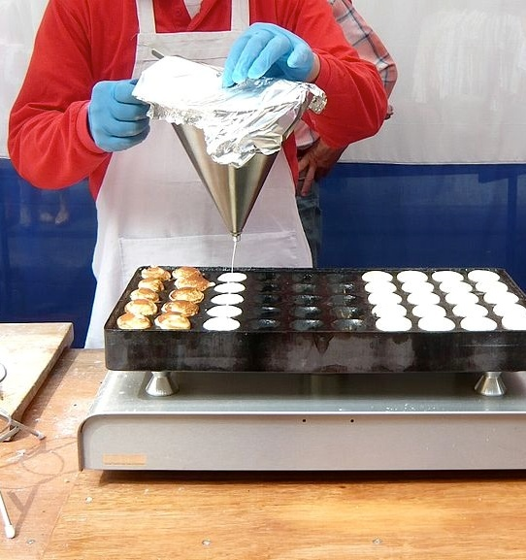
Measuring = counting:
amount of dough =
number of units × 1 unit
http://commons.wikimedia.org/wiki/File:Making_poffertjes-02.jpg
Notes:
3

Slide 4
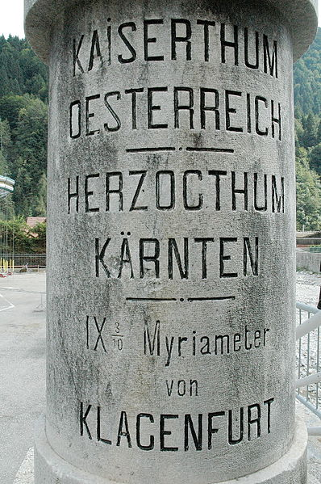
Measuring = counting:
amount of dough =
number of units × 1 unit
https://en.wikipedia.org/wiki/File:Alter_Grenzstein_Pontebba_01.jpg
with unit u₁ find x₁ times
with unit u₂ find x₂ times
... what is REAL quantity?
Notes:
4

Slide 5
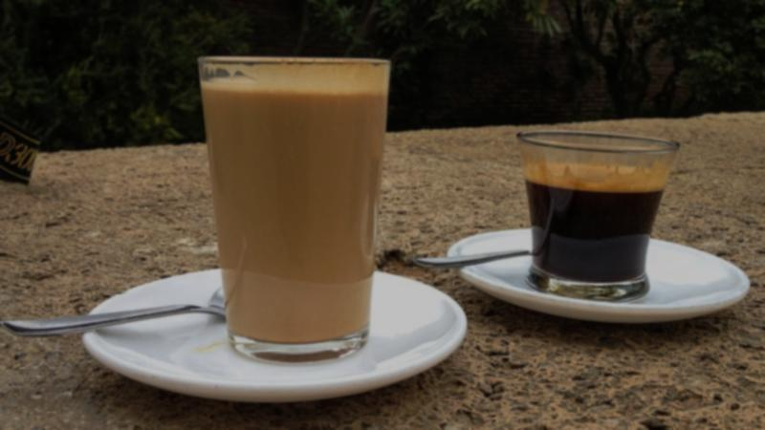
Measuring = counting:
if u₂ fits p₁₂ times in u₁
with unit u₁ find x₁ times
with unit u₂ find x₂ times
... what is REAL quantity?
http://commons.wikimedia.org/wiki/File:Small_and_large_coffee_(6922910764).jpg
Notes:
5

Slide 6
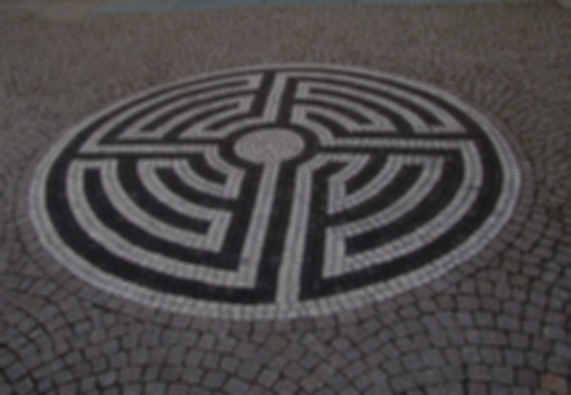
QUIZ
Measuring = counting:
What is the relation between p₁₂ and p₂₁?
if u₂ fits p₁₂ times in u₁
with unit u₁ find x₁ times
with unit u₂ find x₂ times
... what is REAL quantity?
http://commons.wikimedia.org/wiki/File:Small_and_large_coffee_(6922910764).jpg
Notes:
6

Slide 7
Measuring = counting:
if u₂ fits p₁₂ times in u₁
then u₁ = p₁₂ u₂ = 1/p₂₁ u₂.
Since u₁ x₁ = u₂ x₂ ,
x₁ = x₂ / p₁₂ = x₂ * p₂₁
with unit u₁ find x₁ times
with unit u₂ find x₂ times
... what is REAL quantity?
http://commons.wikimedia.org/wiki/File:Small_and_large_coffee_(6922910764).jpg
Notes:
7

Slide 8
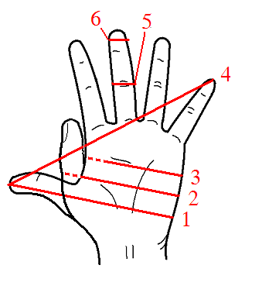
Measuring = counting:
different units: 4 palm + 3 finger = …?
4 * palm + 3 * finger =
4 * palm/finger * finger + 3 * finger =
(4 * palm/finger + 3 ) * finger,
≅ (4 * 6 + 3 ) * finger ≅ 27 finger
p₁₂ = p _{palm finger} ≅ 6
with unit u₁ find x₁ times
with unit u₂ find x₂ times
... what is REAL quantity?
https://en.wikipedia.org/wiki/File:Hand_Units_of_Measurement.PNG
Notes:
8
Complication: x was ‘a number of times’, thus: an integer (counting!). Integers, however, are not closed under division.
Way out: have a series of units (m,dm,cm,mm,…) and assume that x∈Q. (physicists even assume x∈R …)
Eventually, I never can tell what the ‘real’ length of something is; only, by means of a number of scalings, I can express a length as a multiple of something with a standard length.
‘This lantern is 7 m high’- but how long is a meter? A meter is 40 inch. But how long is an inch? ….

Slide 9
QUIZ
Measuring = counting:
A rectangular box has dimensions:
width: 3 palm + 2 finger
depth: 2 palm+3 finger
height: 4 palm+4 finger
What is the volume (exact)?
different units: 4 palm + 3 finger = …?
4 * palm + 3 * finger =
4 * palm/finger * finger + 3 * finger =
(4 * palm/finger + 3 ) * finger,
≅ (4 * 6 + 3 ) * finger ≅ 27 finger
p₁₂ = p _{palm finger} ≅ 6
with unit u₁ find x₁ times
with unit u₂ find x₂ times
... what is REAL quantity?
https://en.wikipedia.org/wiki/File:Hand_Units_of_Measurement.PNG
Notes:
9

Slide 10
Measuring = counting:
Volume of a box, measured in palms and fingers:
(3 p + 2 f)(2 p + 3 f)(4 p + 4 f)=
24 p³ + 76 p² f + 76 p f² + 24 f³
which can not be reduced
unless we know the value of
p _{palm finger}.
with unit u₁ find x₁ times
with unit u₂ find x₂ times
... what is REAL quantity?
https://en.wikipedia.org/wiki/File:Hand_Units_of_Measurement.PNG
Notes:
10

Slide 11
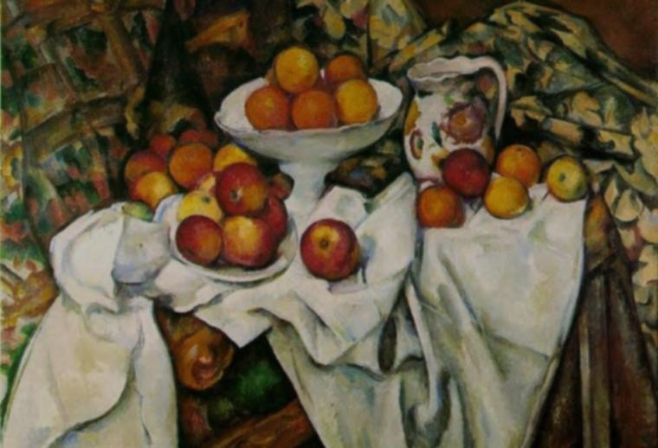
Measuring = multiplying:
‘12.5 cm’ means ‘12.5 x cm’
‘cm’ is an unknown value
But: cm = 10 mm, so
12.5 cm = 12.5 x 10 x mm
because cm = 1 x cm = p _{cm mm} x mm = 10 mm
http://commons.wikimedia.org/wiki/File:Paul_Cezanne_Apples_and_Oranges.jpg
Consequence:
multiply or divide quantities
→ SAME operations on units
adding, subtracting and comparing different units is forbidden
Notes:
11
Restricts adding or subtracting quantities.
To get 1/p ‘out of brackets’, they have to be equal in expressions such as (x₁ p₁₃+x₂ p₂₃)=?
If p₂₃=q p₁₃ this is fine:
(x₁ p₁₃+x₂ q p₁₃ )=(x₁+x₂ q) p₁₃
Otherwise, additions (and therefore also sine, cosine, exponent etc – being power series - ) don’t work! Therefore:
ONLY DO MATH WITH UNIT-LESS (=dimensionless) QUANTITIES.
The expression ‘12.5 cm’ is not merely a notational convention

Slide 12
Summary:
measuring = counting
‘12cm’ means ‘12 x cm’
value of ‘12cm’: only known relative to other units
u₂ fits p₁₂ times in u₁ : u₁ = p₁₂ u₂; u₁ x₁ = u₂ x₂, so x₁ = x₂ / p₁₂
divide, multiply: both values and units
add, subtract, compare: only with equal units
transcendental operations: unit-less quantities only
Notes:
12
The case of the area of a rectangle, being the product of two lengths A and B, both counted as a number of palms (p) and a number of fingers (f): (A_{p}p+A_{f}f) * (B_{p}p+B_{f}f) = A_{p}B_{p} p² +(A_{p}B_{f}+A_{f}B_{p}) pf + A_{f}B_{f} f²

